Slide 1

BARKATULLAH UNIVERSITY INSTITUTION OF TECHNOLOGY
TOPIC :- “INVESTBOOK- A STOCK PRICE PREDICTION WEBAPP”
BRANCH:- COMPUTER SCIENCE(6TH SEMESTER)
SUBMITTED BY:-
RITU BACHLE(R218237200022)
RUSHALI KATHODE(R228237200073)
OJASWI SHARMA(R218237200030)

Slide 2
INVESTBOOK -A STOCK PRICE PREDICTION WEBAPP

Slide 3
CONTENT
Machine Learning (Linear regression)
Deep Learning (LSTM)
Deep Learning Necessity
Google Stock Price Dataset
Streamlit
Pandas
cufflinks
8. Conclusion

Slide 4
ABSTRACT
Demand of Stock have become huge with Increased in popularity of Stock in Digital world. Prediction and Analysing stock can benefit People to think before buying or selling stocks. So, A New Stock Price Prediction through Deep Learning Algorithms has been analyzed and visualized. Through This System we can predict of any Company stock in the world.

Slide 5
MACHINE LEARNING
Machine learning is the science of getting computers to act without being explicitly programmed.
Machine learning is important because it gives enterprises a view of trends in customer behavior and business operational patterns, as well as supports the development of new products.
Linear regression
Linear regression is the analysis of two separate variables to define a single relationship and is a useful measure for technical and quantitative analysis in financial markets. Plotting stock prices along a normal distribution—bell curve—can allow traders to see when a stock is overbought or oversold.

Slide 6
DEEP LEARNING
Deep learning is an artificial intelligence (AI) function that imitates the workings of the human brain in processing data and creating patterns for use in decision making.
Deep learning attempts to mimic the human brain—albeit far from matching its ability—enabling systems to cluster data and make predictions with incredible accuracy.
LSTM(Long Short Term Memory)
LSTM stands for long short-term memory networks, used in the field of Deep Learning. It is a variety of recurrent neural networks (RNNs) that are capable of learning long-term dependencies, especially in sequence prediction problems.

Slide 7
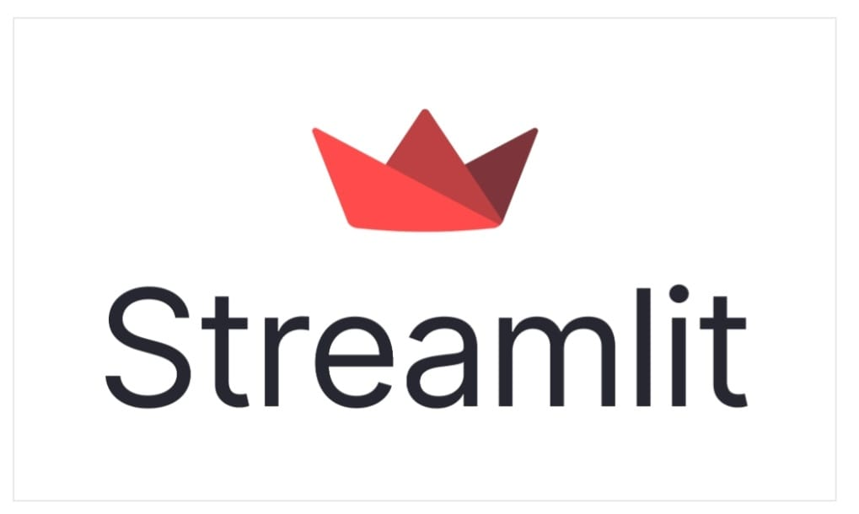
Streamlit
Streamlit is an open-source app framework for Machine Learning and Data Science teams. Create beautiful web apps in minutes.

Slide 8

PANDAS
Pandas is a Python library used for working with data sets.It has functions for analyzing, cleaning, exploring, and manipulating data.

Slide 9
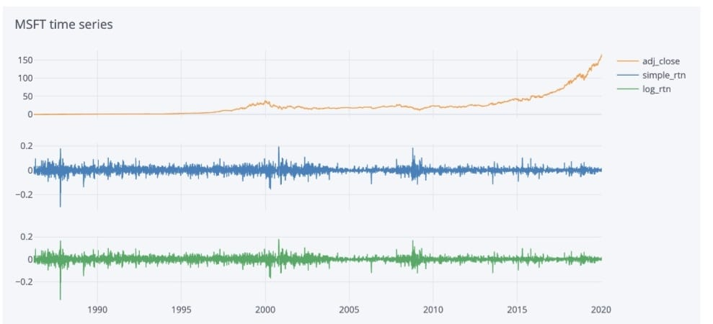
CUFFLINKS
Cufflinks is built on top of another data visualization library named Plotly. The main aim of Cufflinks is to simplify data visualization by providing same API

Slide 10
DEEP LEARNING NECESSITY
Deep learning has evolved hand-in-hand with the digital era, which has brought about an explosion of data in all forms and from every region of the world. This data, known simply as big data, is drawn from sources like social media, internet search engines, e-commerce platforms, and online cinemas, among others. This enormous amount of data is readily accessible and can be shared through fintech applications like cloud computing.
However, the data, which normally is unstructured, is so vast that it could take decades for humans to comprehend it and extract relevant information. Companies realize the incredible potential that can result from unraveling this wealth of information and are increasingly adapting to AI systems for automated support.

Slide 11
GOOGLE STOCK DATASET
Google LLC is an American multinational technology company that specializes in Internet-related services and products, which include online advertising technologies, a search engine, cloud computing, software, and hardware.
It is considered one of the big four Internet stocks along with Amazon, Facebook, and Apple
The company is listed on the NASDAQ stock exchange under the ticker symbol GOOG.
We have Included 5 year Stock Price of Google for this Project.

Slide 12
CONCLUSION
We can see the Prediction, analysis and Visualization of Google stock Price hough applying Deep learning algorithms such as LSTM, DENSE, DROP OUT and SEQUENTIAL.
Same way we can use any company Stock Dataset directly apply this algorithms it will give us the correct prediction.
This System is Successfully runs on any system even on Cloud platforms.

